Slide 1
Google Earth Engine Perth Cloud Meetup
October 2017
Richard Greene

Slide 2
So what is Earth Engine?
First off, Earth Engine is not Google/Bing Maps, but they are similar.
Marketing call it “A planetary-scale platform for Earth science data & analysis” but in another way it’s just a “Very, very large datasets” running on Cloud servers
Has both free public and paid datasets
Main use is research
Show impact on the environment
But there is so much more….

Slide 3






Lets looks at the satellite business
Started with big boys toys
Australia launched a satellite for the UK in 1971.
Capture data “on demand”
Moving to small cheap Nano-sat
Capture data “continually”
2017 Australia announced it was creating a space agency

Slide 4
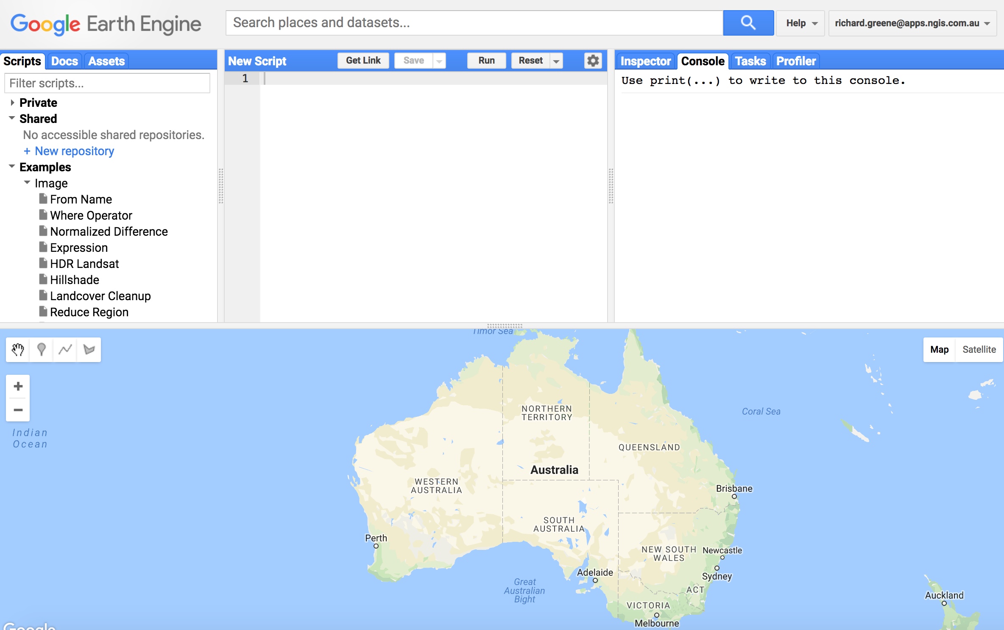
How do you use it?
Use Code Playground
Option 1: Online Code playground

Slide 5


API Code
Two basic options open for developers
Javascript
Python
Both can be downloaded from
https://developers.google.com/earth-engine/
Also Docker images available
Note: These are client side, not server side!
Option 2: Native APIs

Slide 6
Server Side Operation
To get things running Server Side
Download from https://github.com/gena/ee-runner
Your biggest issue will be registration and dealing with security.
Download Json
Download p12 certificate
Lets run a demo
Option 3: EE Runner … Open Source comes to the rescue

